Slide 1
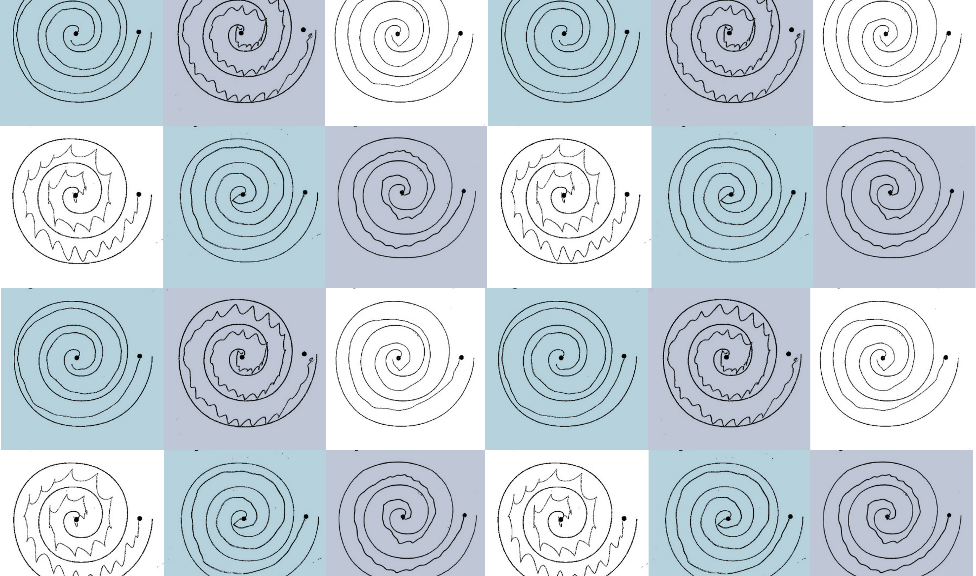
Which Hand?
Robyn Gebbie and Jesse van der Merwe
Project 22P59, Group 22G05

Slide 2
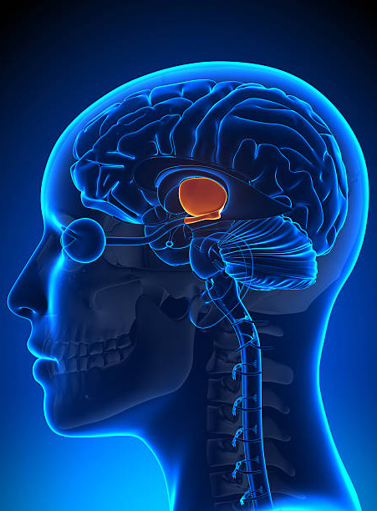
Focused Ultrasound Treatment
Focused Ultrasound is used to treat Parkinson’s Disease and Essential Tremor
This treatment delivers acoustic energy to one side of the patient’s thalamus
This process causes small lesions to form on this part of the brain, interrupting abnormal brain activity and causing the patient to have fewer uncontrollable movements, such as tremor
This treatment only improves the tremor on one side of the patient’s body

Slide 3
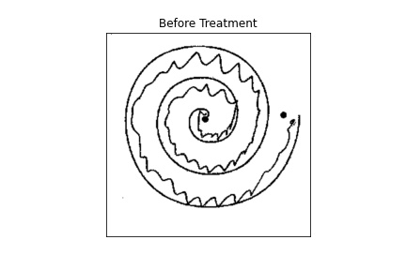
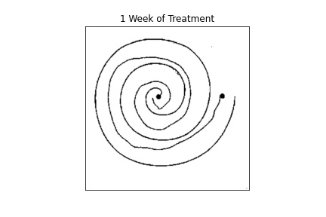
Before Treatment
After Treatment

Slide 4
Finding the Spiral Centre

Slide 5
Finding the Spiral Centre
Finding the Spiral Centre

